Slide 1
MODULE-3: UNSUPERVISED LEARNING

Slide 2
Contents:
Introduction
Self - Organizing Maps
ARTI Architecture
ART1 Algorithm
Applications of ART1
Case study on Anomaly Detection

Slide 3
Classification & Clustering

Slide 4
Datasets
Training Set: a set of examples used for learning, where the target value is known.
Validation Set: A set of examples used to tune the architecture of a classifier and estimate the error.
Test Set: Used only to assess the performance of a module. It is never used during the training process so that the error on the test set provides an unbiased estimate of the generalization error.

Slide 5
Classification:
Divides sample in classes.
Uses a trained set of previously labeled data.
Clustering:
Partitioning of a data set into subsets(clusters) so that data in each subset ideally share some common characteristics.

Slide 6

Classification
Suppose you have a basket filled with some fresh fruits. Your task is to arrange the same type of fruits at one place.
Suppose the fruits are apple, banana, cherry, grape etc.

Slide 7
Classification
You already know from your previous work that, the shape of each and every fruit, so it is easy to arrange the same type of fruits at one place.
Here your previous work is called as training (train data).
You already learn the things from train data, i.e. if some fruit have so and so features it is grape, like that for each and every fruit.

Slide 8
Clustering
In this, you don't know any thing about these fruits, you are first time seeing them.
So how will you arrange the same type of fruits?
You will take one fruit and you will select any physical character of that particular fruit. E.g. color/shape.
Then you will arrange them based on color, then the groups will be something like this:
RED COLOR GROUP: apples & cherry.
GREEN COLOR GROUP: bananas & grapes.

Slide 9
Clustering
You can take another physical character as size, so the groups will be some thing like this:
RED COLOR AND BIG SIZE: apple.
RED COLOR AND SMALL SIZE: cherry fruits.
GREEN COLOR AND BIG SIZE: bananas.
GREEN COLOR AND SMALL SIZE: grapes.

Slide 10
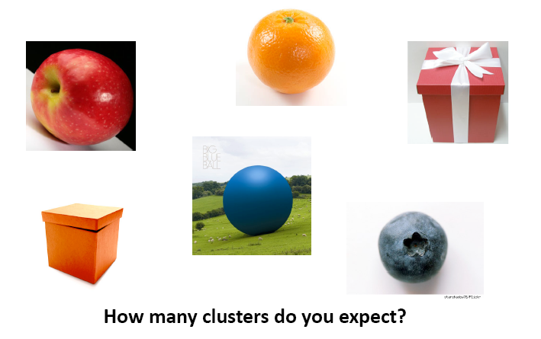

Slide 11
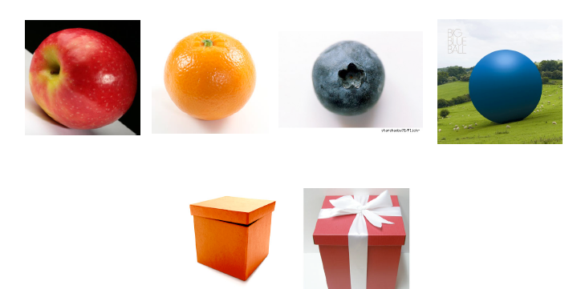
Based on shape

Slide 12
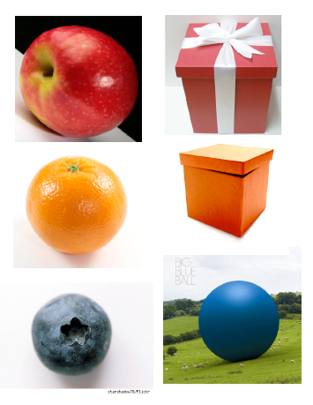
Based on Color

Slide 13
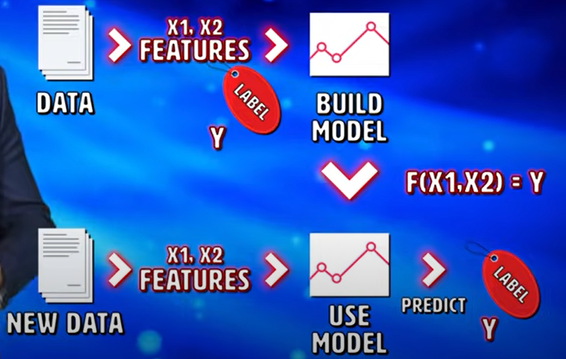

Slide 14


Slide 15
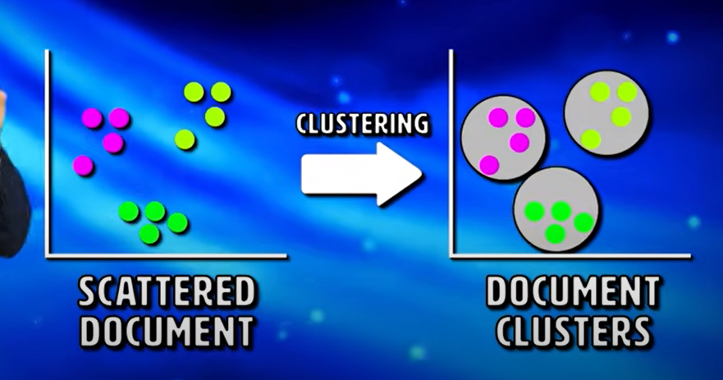

Slide 16
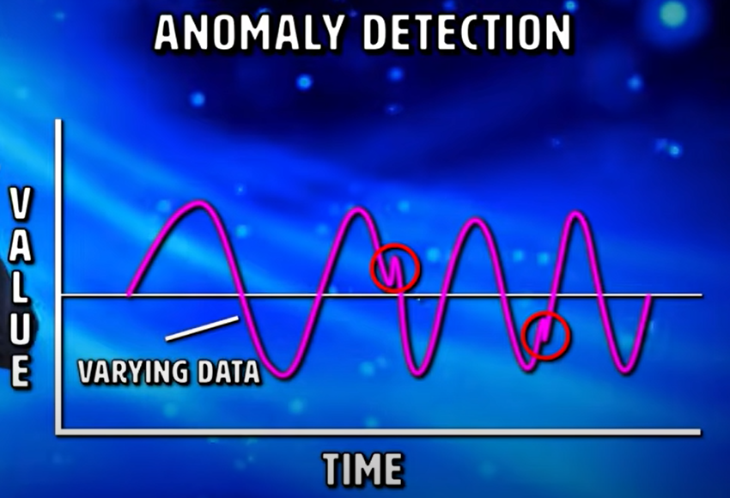

Slide 17
UNSUPERVISED LEARNING

Slide 18
INTRODUCTION
In unsupervised network, desired output is not presented to the network.
Instead, the system must learn on its own by discovering various features in the input patterns.
So, we can say there is no teacher in this method.
These are also called as ‘self-organizing networks’.

Slide 19
INTRODUCTION
While classifying a new pattern, network checks its similarity with patterns that are already classified.
There are various ways to measure the similarity such as Familiarity, PCA, clustering, feature mapping, Prototyping, Encoding etc.
So, based on various criteria a pattern may be classified into more than one classes.

Slide 20
INTRODUCTION
But, only one of several neurons should fire.
To do this, network adds a structure which will force the network to fire only one neuron at a time.
This process is called as ‘competition’.
E.g. Students’ performance

Slide 21
INTRODUCTION
Familiarity:
A single continuous-valued output could tell us how similar a new input pattern is to typical or average patterns seen in the past.
The network would gradually learn what is typical.
PCA:
Uses the leading eigenvector directions of the input patterns’ correlation matrix.

Slide 22
INTRODUCTION
Clustering:
The appropriate categories would have to be found by the network on the basis of the correlations in the input patterns.
Each cluster of similar or nearby patterns would then be classified as a single output class.
Prototyping:
The network might form categories like in clustering, but then give us as output a prototype or exemplar from the appropriate class.
It would then have the function o f an associative memory

Slide 23
INTRODUCTION
Encoding:
The output could be an encoded version o f the input, in fewer bits, keeping as much relevant information as possible.
This could be used for data compression prior to transmission over a limited-bandwidth channel.
Feature Mapping:
If the output units had a fixed geometrical arrangement (e.g. 2D array) with only one on at a time, they could map input patterns to different points in this arrangement.

Slide 24
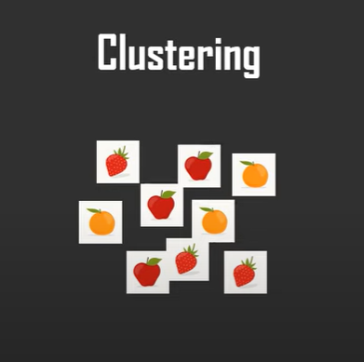
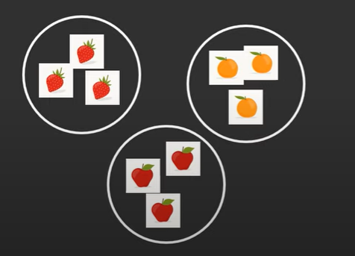
INTRODUCTION
Clustering is based on the pattern matching.
It will identify the similar pattern or a features and makes the clusters.

Slide 25
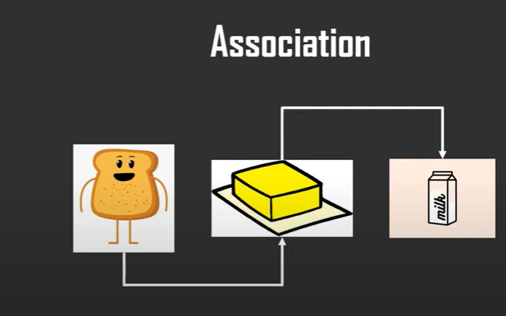
INTRODUCTION
Association finds the dependencies of one data item to another data item and map them such that they will maximize your profit

Slide 26
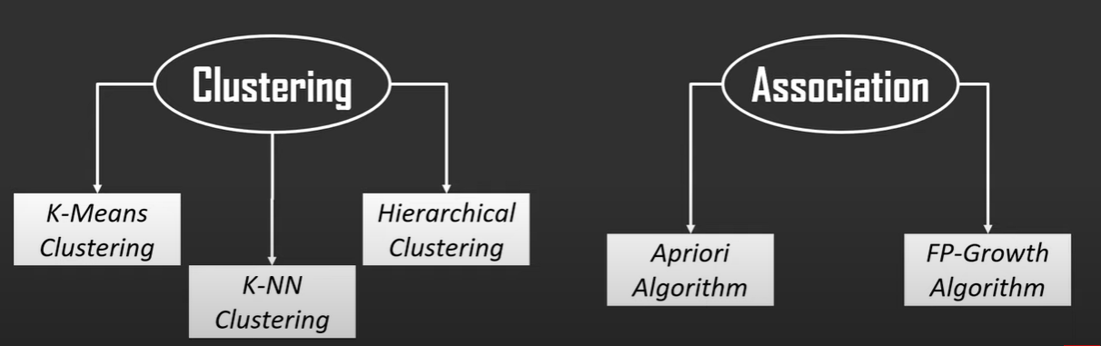
INTRODUCTION

Slide 27
INTRODUCTION
Unsupervised learning may be useful even in situations where supervised learning would be possible:
Multi-layer back-propagation is extremely slow, in part because the best weight in one layer depends on all the other weights in all the other layers.
Even after training a network with supervised learning, it may be advisable to allow some subsequent unsupervised learning so that the network can adapt to gradual changes or drift in its environment or sensor readings.

Slide 28
INTRODUCTION
EXAMPLES:
Maxnet
Mexican Hat
Hamming Net
Kohonen self-organizing feature map
Adaptive Resonance Theory (ART)
Learning Vector Quantization

Slide 29
Disadvantages
You may never know the method of how the data was sorted by the algorithm
It provides less accurate outputs
Output provided may not be what the user was expecting due to data interpretation mismatch
Output obtained has to be understood by the user and mapped with corresponding labels.

Slide 30
ART: ADAPTIVE RESONANCE THEORY
Developed by Stephen Grossberg and Gail Carpenter in 1987
Unsupervised learning network, based on competition to form clusters
Developed to solve the problem of instability occurring in feed-forward networks

Slide 31
ART: CONTINUED…
What happens during training of neural network?
A training pattern is presented several times to the net.
A pattern may be placed in one cluster for the first time and then on a different cluster next time
Reason: Changes in the cluster weights due to other pattern.
This is called as ‘instability’ of the network.

Slide 32
ART: CONTINUED…
What happens during training of neural network?
Also presenting same patterns to the net doesn’t allow the network to learn a new pattern easily
This is a problem of plasticity of network
Ability of Net to respond to a new pattern equally at any stage of learning is called plasticity.
This is called ”Stability-Plasticity Dilemma”

Slide 33
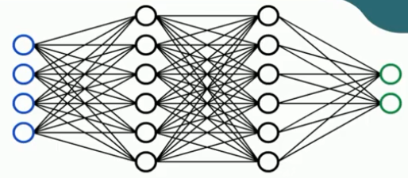

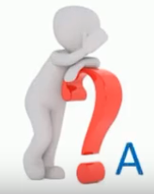

ART: CONTINUED…

Slide 34
ART: CONTINUED…
ART nets are designed to be both stable and plastic
Stability:
Gradually reducing the learning rate for the same pattern.
Plasticity:
Adding feedback mechanism from competitive layer to the input layer.

Slide 35
ART: TYPES
ART1: Clustering Binary input vectors
ART2: Clustering Real valued input vectors
ARTMAP: Supervised version of Binary ART
Fuzzy ART: Synthesis of ART and Fuzzy Logic
Fuzzy ARTMAP: Supervised Fuzzy ART
And many other

